Slide 1

ME23312 ENGINEERING THERMODYNAMICS
Unit III – Properties of Pure Substance · Presentation 9 of 10
Non-flow Processes of Steam – Work and Heat Transfer
First law for a closed system with steam · constant volume, constant pressure, isothermal, hyperbolic, isentropic and polytropic processes · the four-step procedure · the constant-volume trap
Dr. Anantha Raman L., M.E., Ph.D. · Associate Professor, Department of Mechanical Engineering, Rajalakshmi Institute of Technology, Chennai

Slide 2

In this presentation
The first law with steam
The standard non-flow processes
Constant-volume and constant-pressure processes
Isothermal and hyperbolic processes
Isentropic and polytropic processes
The four-step procedure
The constant-volume trap
ME23312 Engineering Thermodynamics · Unit III · Presentation 9
2

Slide 3
The first law with steam
1
ME23312 Engineering Thermodynamics · Unit III · Presentation 9
3

Slide 4
Closed systems with steam
Steam in a cylinder or a rigid vessel: Q = ΔU + W, with W = ∫ p dV for a quasi-static process
Unlike an ideal gas, steam has no simple equation of state
Properties at the end states come from the tables; the process relation only fixes the end state and evaluates the work
ME23312 Engineering Thermodynamics · Unit III · Presentation 9
4

Slide 5
The standard non-flow processes (per kg)
Process | Condition | Work W1–2 | Heat Q1–2
Constant volume | v₂ = v₁ | 0 | u₂ – u₁
Constant pressure | p₂ = p₁ | p (v₂ – v₁) | h₂ – h₁
Isothermal | T₂ = T₁ | q – (u₂ – u₁) | T (s₂ – s₁) (reversible)
Hyperbolic | pv = C | p₁v₁ ln (v₂/v₁) | (u₂ – u₁) + W
Isentropic | s₂ = s₁ | u₁ – u₂ | 0
Polytropic | pv^{n} = C | (p₁v₁ – p₂v₂)/(n – 1) | (u₂ – u₁) + W
ME23312 Engineering Thermodynamics · Unit III · Presentation 9
5

Slide 6
The processes one by one
2
ME23312 Engineering Thermodynamics · Unit III · Presentation 9
6

Slide 7
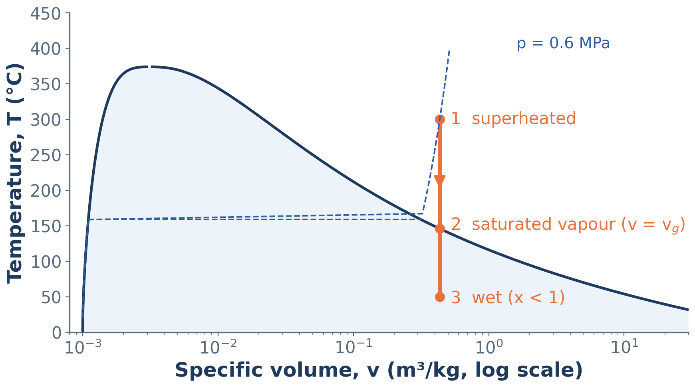
Constant-volume cooling of superheated steam
A rigid vessel: the steam becomes saturated where the vertical line meets the saturated vapour line (v = v_{g}) and is wet below it
ME23312 Engineering Thermodynamics · Unit III · Presentation 9
7

Slide 8
Constant volume and constant pressure
Constant volume (rigid vessel)
Constant pressure
W = 0, Q = m (u₂ – u₁)
On cooling, superheated steam becomes saturated when v_{g}(T) = v
Then wet, with x = (v – v_{f})/v_{fg}
W = p (V₂ – V₁), Q = m (h₂ – h₁)
Boilers and condensers
In the wet region it is also isothermal
ME23312 Engineering Thermodynamics · Unit III · Presentation 9
8

Slide 9
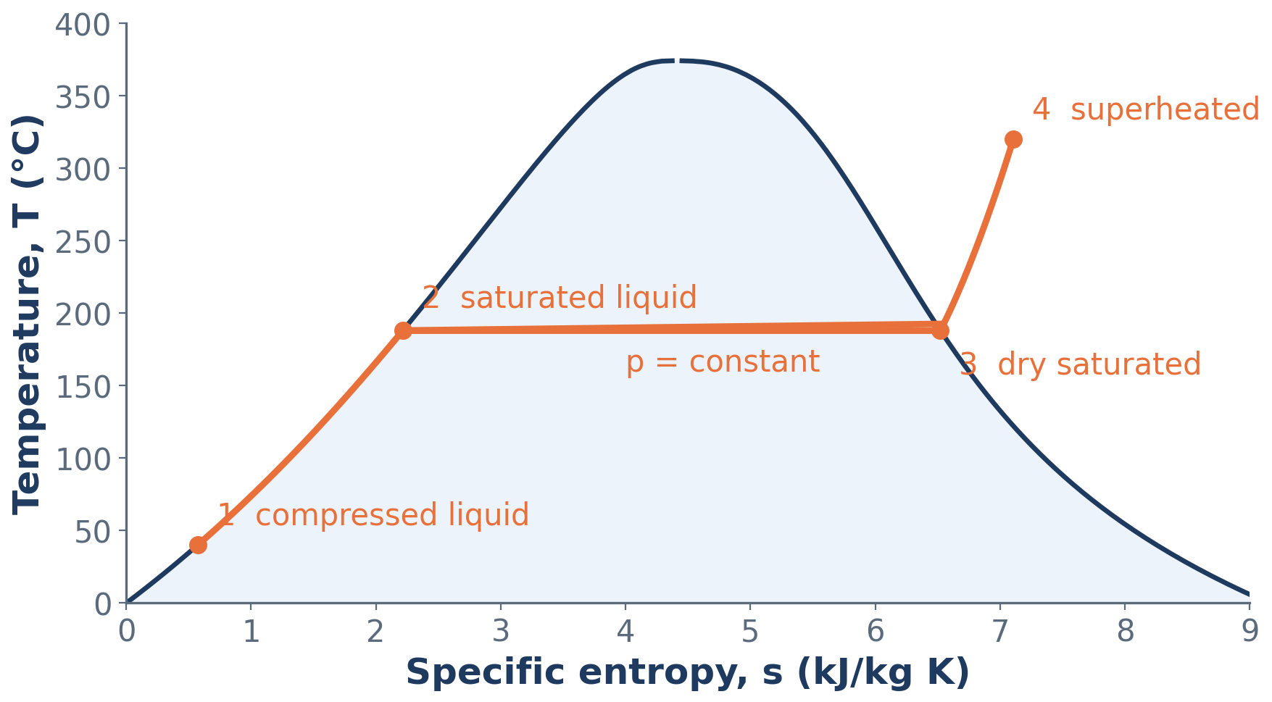
Constant-pressure heating to superheated steam
Compressed liquid → saturated liquid → dry saturated → superheated on the T–s diagram; Q = area under the curve = h₄ – h₁
ME23312 Engineering Thermodynamics · Unit III · Presentation 9
9

Slide 10
Isothermal and hyperbolic processes
Isothermal
Hyperbolic, pv = C
Reversible: Q = m T (s₂ – s₁); W = Q – ΔU
In the wet region identical with constant pressure
In the superheated region p falls as v rises
W = p₁V₁ ln (V₂/V₁); Q = ΔU + W
Not isothermal for steam – only for an ideal gas
ME23312 Engineering Thermodynamics · Unit III · Presentation 9
10

Slide 11
Isentropic and polytropic processes
Isentropic, s₂ = s₁
Polytropic, pv^{n} = C
Reversible adiabatic: Q = 0, W = m (u₁ – u₂)
Ideal expansion in engines
Exit dryness from s₂ = s_{f} + x₂ s_{fg}
W = (p₁V₁ – p₂V₂)/(n – 1); Q = ΔU + W
n ≈ 1.13 for wet steam, 1.3 for superheated steam (Zeuner)
v₂ from the process law, then x₂ or T₂ from the tables
ME23312 Engineering Thermodynamics · Unit III · Presentation 9
11

Slide 12
Procedure and pitfalls
3
ME23312 Engineering Thermodynamics · Unit III · Presentation 9
12

Slide 13
The four-step procedure
Fix state 1 from the tables
Use the process condition (v, p, T, s constant or pv^{n} = C) with one given quantity to fix state 2 – decide first whether state 2 is wet or superheated
Read u₂, h₂, s₂
Compute W from the process and Q from the first law; multiply by the mass m
ME23312 Engineering Thermodynamics · Unit III · Presentation 9
13

Slide 14
The constant-volume trap
In a closed system Q = ΔU + W. Only for a constant-pressure process does Q equal the enthalpy change.
Rigid vessel: W = 0 and Q = ΔU – use u = h – pv, not h₂ – h₁
ME23312 Engineering Thermodynamics · Unit III · Presentation 9
14

Slide 15
Summary
Steam has no equation of state – end states from the tables, work from the process law
Constant volume: W = 0, Q = mΔu; constant pressure: W = pΔV, Q = mΔh
Isothermal: Q = mTΔs; hyperbolic: W = p₁V₁ ln (V₂/V₁) – not isothermal for steam
Isentropic: Q = 0, W = –mΔu, x₂ from s; polytropic: W = (p₁V₁ – p₂V₂)/(n – 1)
Procedure: fix state 1 → fix state 2 (wet or superheated?) → read properties → W and Q
Always Q = ΔU + W; Q = ΔH only at constant pressure
ME23312 Engineering Thermodynamics · Unit III · Presentation 9
15

Slide 16
Next: Flow processes and the two laws for steam
Turbine, nozzle, throttling and mixing with the tables and the Mollier chart
Isentropic efficiency, entropy generation and feasibility
Numerical problems: Worked Examples 3.7 – 3.10 in the lecture notes
ME23312 Engineering Thermodynamics · Unit III · Presentation 9
16

